Slide 1

Blockchain
Prof. Sunitha R
Department of Computer Science and Engineering

Slide 2


Blockchain
Consensus Algorithm: Proof of Work (PoW)
Prof. Sunitha R
Department of Computer Science and Engineering

Slide 3
Blockchain
Consensus Algorithm – Proof of Work(PoW)
The idea for Proof of Work(PoW) was first published in 1993 by Cynthia Dwork and Moni Naor
Applied by Satoshi Nakamoto in the Bitcoin paper in 2008.
Competitive consensus algorithms .
Solving a computational challenging puzzle in order to create new blocks.
The term “proof of work” was first used by Markus Jakobsson and Ari Juels in a publication in 1999.

Slide 4
Blockchain
Consensus Algorithm – Principle
A solution that is difficult to find but is easy to verify.

Slide 5
Blockchain
Consensus Algorithm – Proof of Work(PoW)
Idea
Find or generate a value which is
Difficult to generate (in terms of CPU power)
And yet easily verifiable
Example:
N leading zeros
If n=4, block hash should have 4 leading zeros
0000AC23EF32DD3422…
More the value of n more the difficulty

Slide 6
Blockchain
Consensus Algorithm – Proof of Work(PoW)
Each node(miners) needs to solve math puzzle to propose transaction.
Lot of computation, power and time
Finding hash value based on the input message + hash value of the previous block.
Math puzzle should be less than the difficulty level of the systems
Once puzzle is solved, all other nodes should agree to solution.
The node that is first solve, rewarded for his work
Courtesy: https://www.udemy.com/course/building-Blockchain-applications-using-ethereum-hyperledger-fabric/

Slide 7
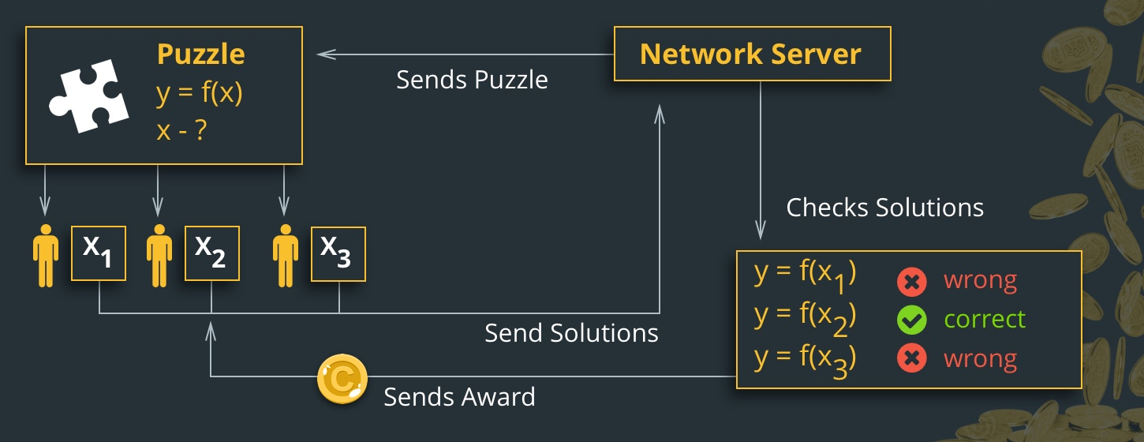
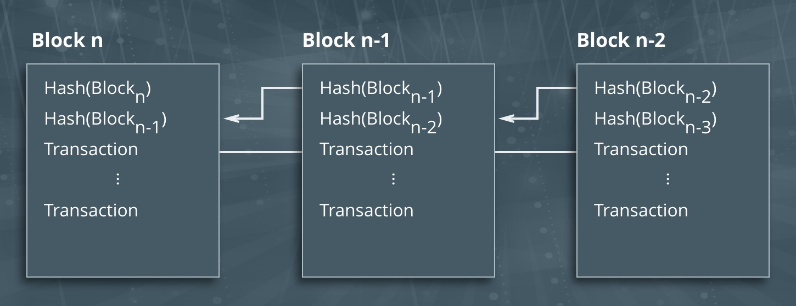
Blockchain
How is this algorithm implemented in Blockchain?

Slide 8
Blockchain
Consensus Algorithm – Proof of Work(PoW)
Block 1
Hash 1
Block 2
Hash 2
Block 3
Hash 3
Example
New Block, block 3 needs to be added to the existing chain.
Calculate hash3
H(Block 3,hash 2, Nonce) < Difficulty level (0000000….234)
Incrementing nonce help in solving puzzle

Slide 9
Blockchain
Consensus Algorithm – Proof of Work(PoW)
Example:
Iteration 1- H(Block 3,hash 2, 1) < Difficulty level (0000000….234) outcome –No
Iteration 2 H(Block 3,hash 2, 2) < Difficulty level (0000000….234) outcome –No
…
Iteration 2000007- H(Block 3,hash 2, 2000007) < Difficulty level (0000000….234) outcome –yes
Verification by other nodes using nonce=2000007

Slide 10
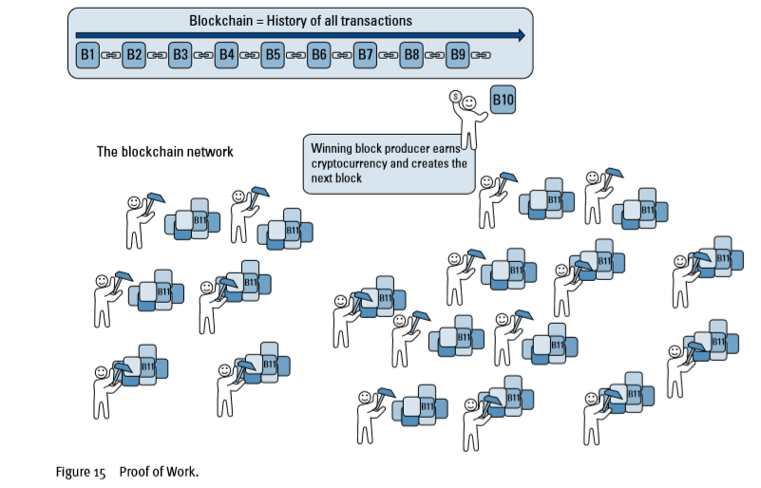
Blockchain
Consensus Algorithm – Proof of Work(PoW)

Slide 11
Blockchain
Consensus Algorithm – Proof of Work(PoW)
Cryptocurrencies using PoW:
Litecoin
Ethereum
Monero coin
Dogecoin
Miners receive 12.5 bitcoins for finishing first

Slide 12
Blockchain
Bitcoin’s Proof-of-Work system
Bitcoin uses the Hashcash Proof of Work system as the mining basis.
The ‘hard mathematical problem’ can be written in an abstract way like below :
Given data A, find a number x such as that the hash of x appended to A results is a number less than B.

Slide 13
Blockchain
Hashcash
Hashcash is a proof-of-concept system proposed in 1997 that demonstrates an implementation of this idea.
Hashcash is designed to combat email spam. Hashcash adds the following header to the email:
X-Hashcash: 1:20:1303030600:adam@cypherspace.org::McMybZIhxKXu57jd:ckvi
The header contains:
ver: Hashcash format version, 1 (which supersedes version 0).
bits: Number of "partial pre-image" (zero) bits in the hashed code.
date: The time that the message was sent, in the format YYMMDD[hhmm[ss]].
resource: Resource data string being transmitted, e.g., an IP address or email address.
ext: Extension (optional; ignored in version 1).
rand: String of random characters, encoded in base-64 format.
counter: Binary counter, encoded in base-64 format.

Slide 14
Blockchain
Consensus Algorithm – Proof of Work(PoW)
Protected from corruptions as long as 51% or more of the block being created by miners are legitimate
Pros:
It has been tested since 2009 and still works great
It is slower and safer- you know your transaction will not be rolled back.
It is trustless - no one can block your transaction from processing

Slide 15
Blockchain
Consensus Algorithm – Proof of Work(PoW)
Cons:
The 51% risk
It is slow- you have to wait for your transaction to be confirmed.
It is costly- transaction costs can go up with the number of users.
It is susceptible to centralization over time- those with the most resources can pool together their efforts in mining.

Slide 16
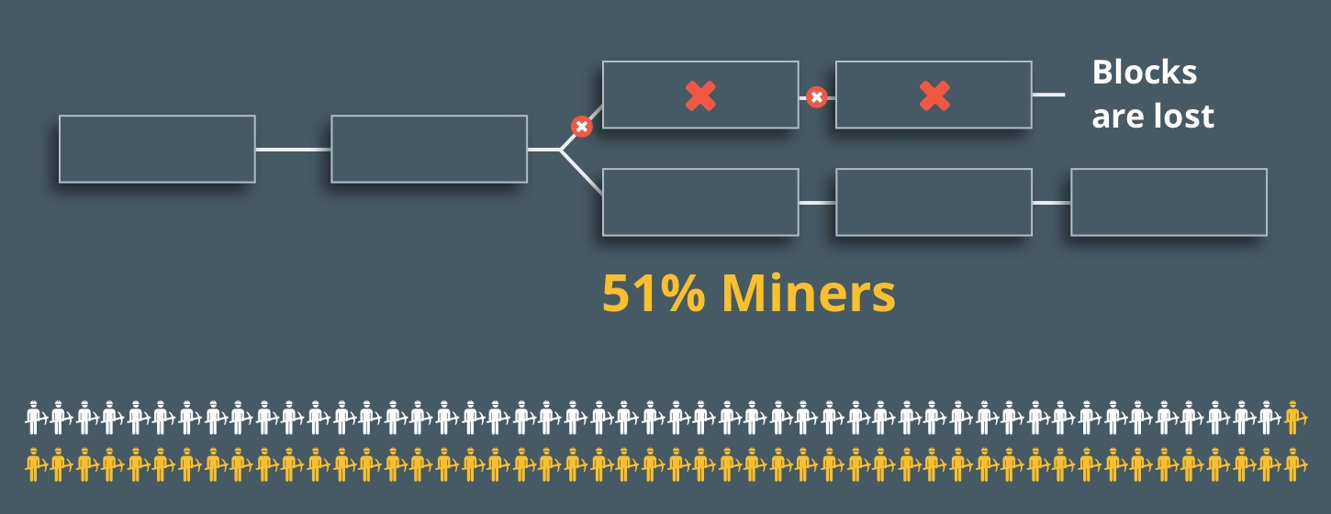
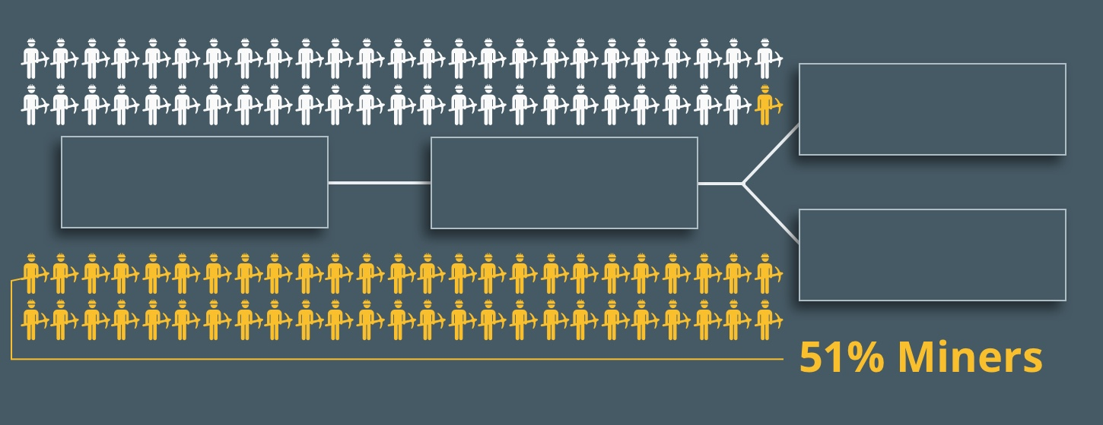
Blockchain
Consensus Algorithm – Proof of Work(PoW)

Slide 17
Blockchain
Supplementary readings
https://www.youtube.com/watch?v=dW2Jit8ViGI
https://www.udemy.com/course/building-Blockchain-applications-using-ethereum-hyperledger-fabric/

Slide 18
THANK YOU
Prof. Sunitha R
Department of Computer Science and Engineering
sunithar@pes.edu

